Slide 1
Version Control

Slide 2
What is Version control?
Version control:
Version control enables multiple people to simultaneously work on a single project. Each person edits his or her own copy of the files and chooses when to share those changes with the rest of the team. Thus, temporary or partial edits by one person do not interfere with another person's work.
What are the benefits of using version control?
Troubleshooting issues; revert back to earlier versions to track changes and compare differences.
Allow you to compare files, identify differences, and merge the changes if needed prior to committing any code.
When new developers join the team, they can easily download the current version of the application to their local environment using the version control system and are able to keep track of the version they’re currently running.

Slide 3
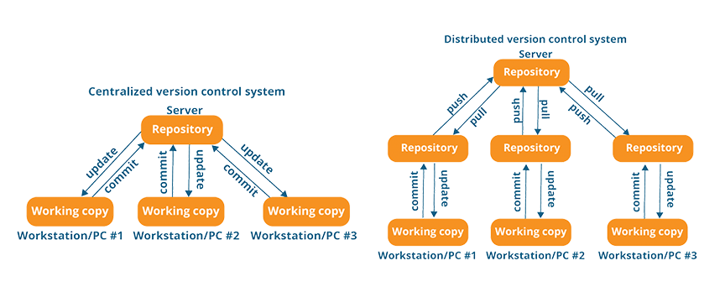
Types of Version Control
Centralised Version Control system
Distributed Version Control system

Slide 4
Comparison
GIT
Apache Subversion
Mercurial
Pros:
Great for those who hate CVS/SVN
Dramatic increase in operation speed
Full history tree available offline
Distributed, peer-to-peer model
Cons:
Learning curve for those used to SVN
Not optimal for single developers
Limited Windows support compared to Linux
Pros:
Easier to learn than Git
Better documentation
Distributed model
Cons:
No merging of two parents
Extension-based rather than scriptability.
Less out of the box power
Pros:
Newer system based on CVS
Includes atomic operations
Cheaper branch operations
Wide variety of plug-ins for IDEs
Does not use peer-to-peer model
Cons:
Still contains bugs relating to
renaming files and directories
Insufficient repository management
commands
Slower comparative speed

Slide 5
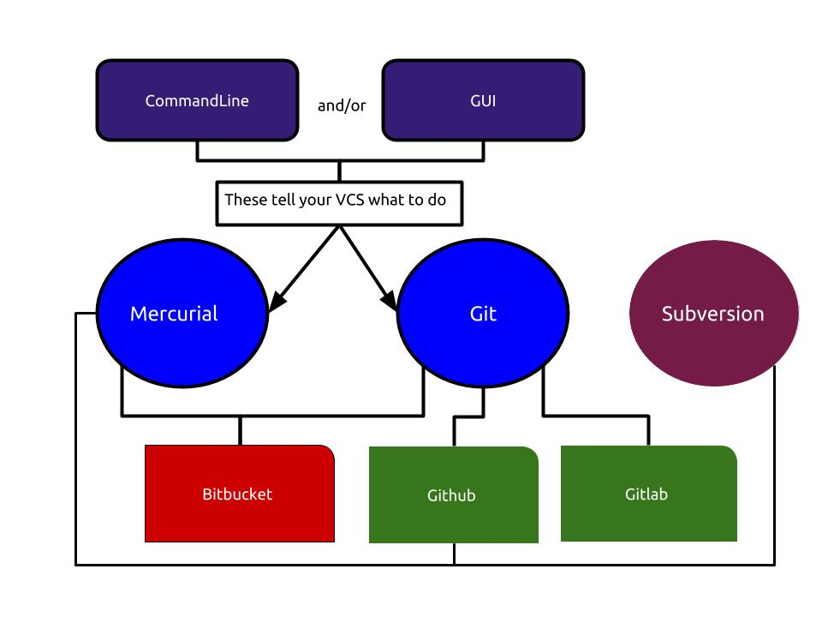
Version Control Architecture
Notes:
revision control system, a tool to manage your source code history.
Remote hosting service for Git repositories. So they are not the same thing: Git is the tool, GitHub is the service for projects that use Git.
GUI – still need command line

Slide 6
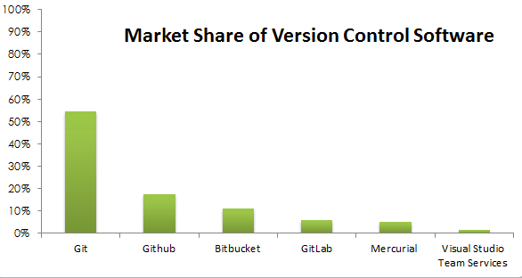
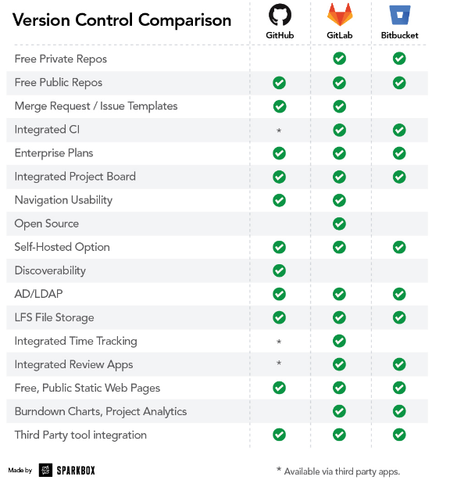
What are our options?
Github | Gitlab | Bitbucket
$25 a month for 5 users then an additional $9 (per user/per month) | $4-99 per user/per month | $2 or $5 a month per a user, alternatively free for up to 5 users
 |  | Trello
 |  | Mercurial or Git
Notes:
https://www.datanyze.com/market-share/source-code-management/git-market-share – graph source
Explain why we chose git and github
User research
it’ll cost £300 a year roughly – option to get a corporate account as it’s currently used in Digital Services. We don’t know if we need to have private repositories.
Benefits of using Git – decent website store repos, easy for people to download install your packages, track history(and commits)

Slide 7


Best practice in Version Control
Document everything
Don’t commit half - done work
Commit early and often
Test before you commit
Write a good commit message with a short summary of changes
Version control is not a back up system
Comply to agreed conventions and workflow and be a team player

Slide 8
Information Governance
What we know:
It is safe for commercial use.
It is already used within the council.
Things to consider:
Security – Does the code contain sensitive information?
Cloud storage – How do we ensure the safety of the data storage?
Account safety – Establish council accounts - Ensure password strength
Hacking – How do we keep accounts as secure as possible?
Malicious code – can people access and alter the code?
Documentation – are the correct procedures in place?
Open Source – Is the code open source or private?

Slide 9
Basic Concepts in Version Control
Tracking changes
- As you make changes, it will track each change behind the scenes. The process will be transparent to you until you are ready to commit those changes.
Committing
- The version control system will wait for you to submit your changes as a single collection of actions. In version control, this collection of actions is known as a commit.
Conflicts
- Conflicts occur when two or more people change the same file(s) at the same time. The version control system does not allow people to overwrite each other’s changes blindly, but highlights conflicts so that they can be resolved.

Slide 10
Basic Concepts in version control
Diffing
- By viewing a diff, you can compare two files or even a set of files to see what lines of code changed, when it changed and who changed it.
Branching
- A branch allows you to create a copy (or snapshot) of the repository that you can modify in parallel without altering the main set. You can continue to commit new changes to the branch as you work, while others commit to the trunk or master without the changes affecting each other.
Merging
- By merging the branch with the trunk or master (or even another branch), your version control tool will attempt to seamlessly merge each file and line of code automatically. Once a branch is merged it then updates the trunk or master with the latest files.

Slide 11
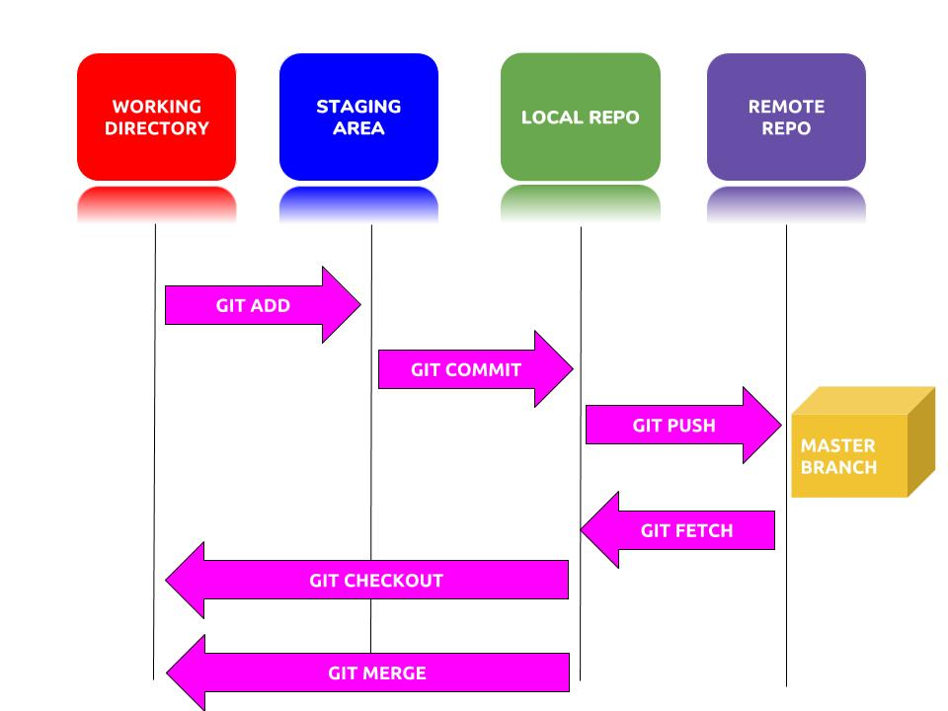
Git Process
Notes:
Local vs remote repository
Master vs Branch – struggled
Proxy – work WITH the councils proxy
Binary vs non binary (check)
Issues
Markdown – way to style text on web

Slide 12

Giving it a Go
Create local repository
Add files
Commit
Checking status

Slide 13



What do you think?

Slide 14
Resources
https://www.youtube.com/watch?v=Loav1kbA640&feature=youtu.be&fbclid=IwAR0dMGVDO9Cfzye6BjINKHTjN0KYzs0fZ6iz9tq0BS09BKGOC_y9FUA2ITw
https://guides.github.com/introduction/flow/
http://guides.beanstalkapp.com/version-control/intro-to-version-control.html
https://www.youtube.com/watch?v=Loav1kbA640&feature=youtu.be&fbclid=IwAR0dMGVDO9Cfzye6BjINKHTjN0KYzs0fZ6iz9tq0BS09BKGOC_y9FUA2ITw
https://guides.github.com/introduction/flow/
https://biz30.timedoctor.com/git-mecurial-and-cvs-comparison-of-svn-software
https://help.github.com/articles/keeping-your-account-and-data-secure/
https://help.github.com/articles/github-corporate-terms-of-service/
https://help.github.com/articles/entering-a-data-protection-agreement-with-github-for-gdpr-compliance/

